Slide 1
UNIT I: VECTOR ANALYSIS
Presentation by
Dr. Rajasi Mandal
Assistant Professor
EEE
SSN College of Engineering

Slide 2
Session Objectives
  To understand the basic mathematical concepts related to electromagnetic vector fields

Slide 3
Session Outcomes
  Students will be able to describe and solve problems using vector analysis in orthogonal coordinate systems. (CO1)

Slide 4
Session Outline
  Types of Physical Quantities – Scalar and Vector
  Dot Product or Scalar Product of Vectors
  Cross Product or Vector Product of Vectors
  Types of Fields – Scalar Field and Vector Field
  Vector Differential Operator or Del Vector or Nabla Vector
  Gradient
  Divergence
  Curl
  Solenoidal Vector
  Irrotational Vector
  Area Vector
  Flux of a Vector
  Line Integral, Surface Integral, and Volume Integral
  Gauss’s Divergence Theorem
  Stokes’s Theorem

Slide 5
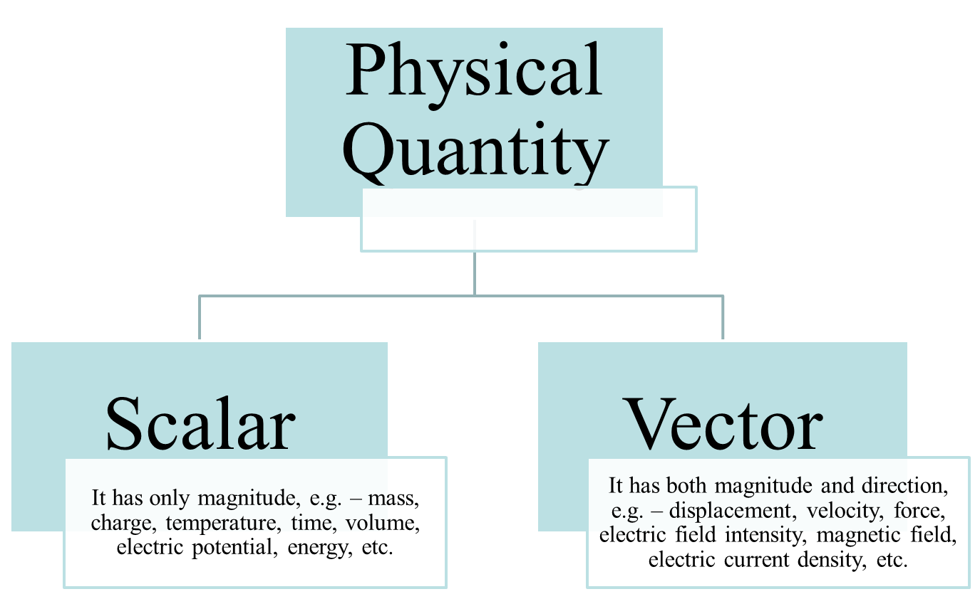
Classification of Physical Quantities

Slide 6
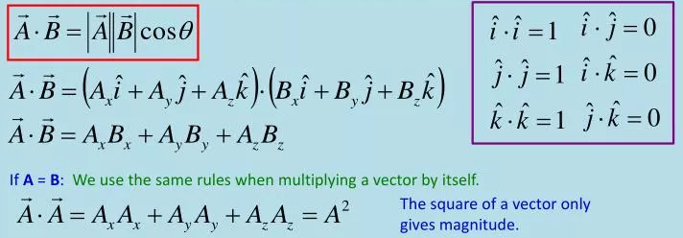
Dot Product or Scalar Product of Vectors
The dot product of two vectors is a scalar.
Examples – Work done, Power, Electric flux, Magnetic flux.

Slide 7
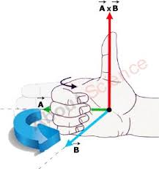
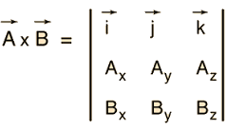
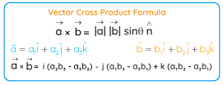
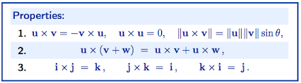
Cross Product or Vector Product of Vectors
The cross product of two vectors is a vector.
Examples – Torque, Angular momentum, Linear velocity.

Slide 8
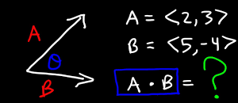
Test Your Understanding (Part-A)
State whether the following are Scalar or Vector?
  Dot Product of Vectors
  Cross Product of Vectors
Calculate the dot product and the cross product of the two vectors.

Slide 9
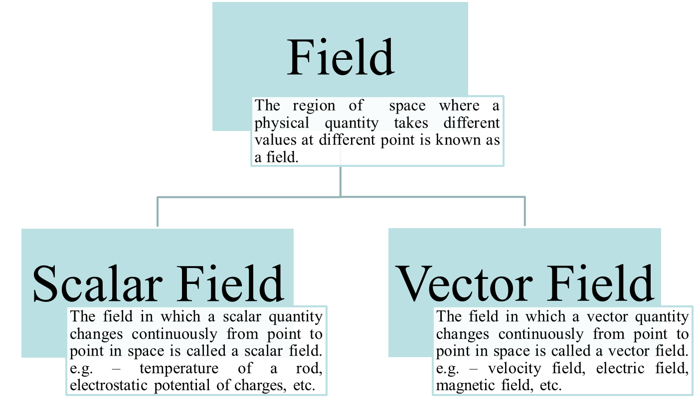
Classification of Field

Slide 10
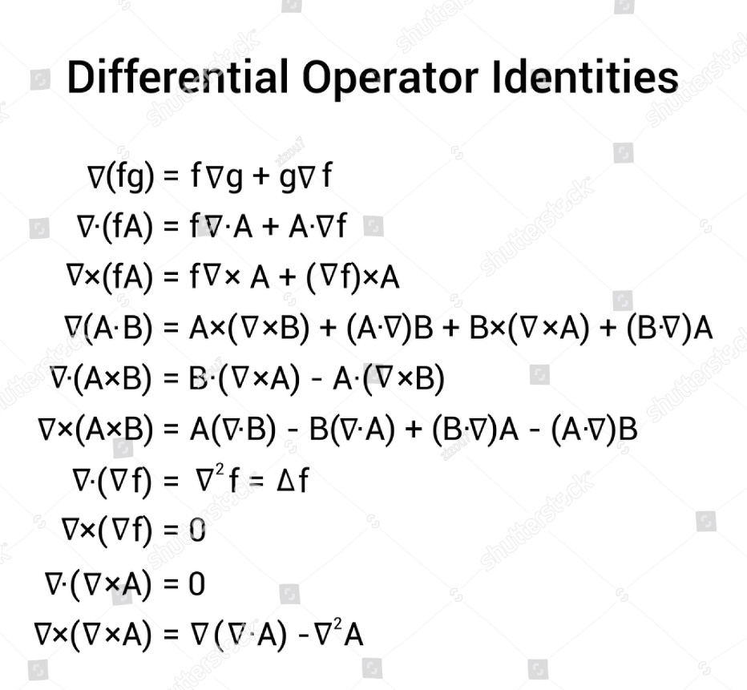
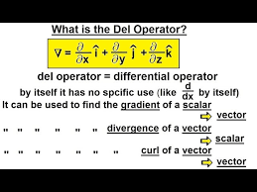
Vector Differential Operator or Del Vector or Nabla Vector

Slide 11
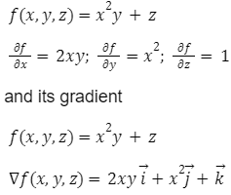
Gradient
When the vector differential operator operates on a scalar, then the obtained vector is called the gradient of the scalar.
Example: Find the gradient of the given scalar field f(x,y,z).

Slide 12
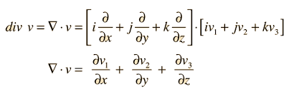
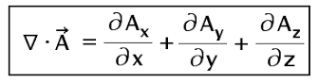
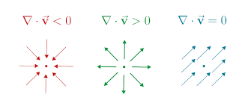
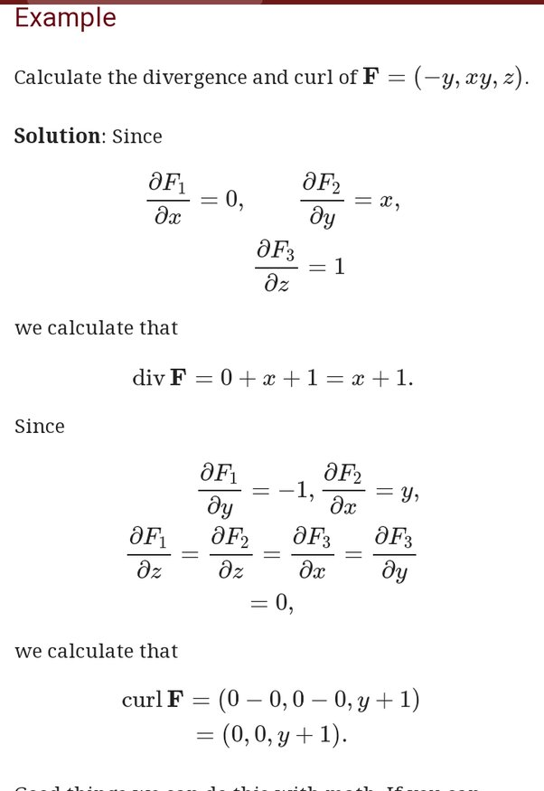
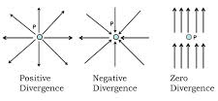
Divergence
When del dot operation is performed on a vector, the obtained scalar is called the divergence of the vector.
Example: Find the divergence of the given vector field F.
A positive divergence indicates outflow.
A negative divergence indicates inflow.

Slide 13
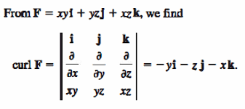
Curl
When del cross operation is performed on a vector, the obtained vector is called the curl of the vector.
Example: Find the curl of the given vector field F.

Slide 14
Solenoidal Vector
If the divergence of any vector is zero, then the vector is called a solenoidal vector or a rational vector.
Irrotational or Conservative or Lamellar Vector
If the curl of any vector is zero, then the vector is called an irrotational vector or a conservative vector / field or lamellar vector.
.

Slide 15
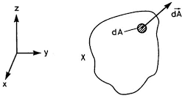
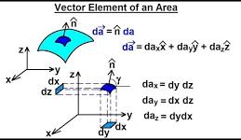
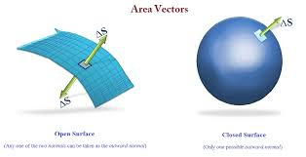
Area Vector
Area vector is a vector whose magnitude is equal to the area and the direction is outward and normal to small area element on the surface.

Slide 16
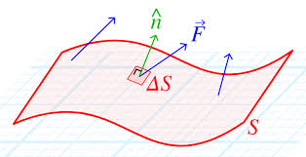
Flux of a Vector
The flux of a vector across any elementary area is defined as the dot product or scalar product of the vector with elementary area.
dϕ = F dS cosθ

Slide 17
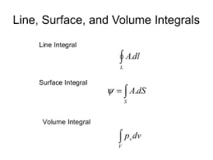
Line Integral, Surface Integral, Volume Integral

Slide 18
Test Your Understanding (Part-B)
What are scalar field and vector field?
Define the following terms:
  Solenoidal Vector
  Irrotational Vector
State whether the following are Scalar or Vector?
  Gradient of a Scalar
  Divergence of a Vector
  Curl of a Vector
  Area
  Volume
  Del Operator
  Flux of a Vector
Calculate the divergence and the curl of the given vectors A and B.

Slide 19

Gauss’s Divergence Theorem
The surface integral of the normal component of a vector F over a closed surface S enclosing a volume V is equal to the volume integral of the divergence of the vector F over the volume V.

Slide 20
Stokes’s Theorem
The line integral of a vector F around a closed curve C is equal to the surface integral of the curl of that vector F over the surface S bounded by that closed curve C.

Slide 21
Test Your Understanding (Part-C)
State the following theorems:
  Gauss’s Divergence Theorem
  Stokes’s Theorem

Slide 22
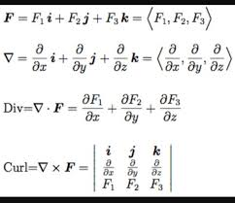
Summary

Slide 23
References
A Text Book on Classic Engineering Physics, Amal Kr. Chakrabarty.
Engineering Electromagnetics, William H. Hayt, Jr., John A. Buck.
Field and Wave Electromagnetics, David K. Cheng, Pearson New International Edition.
Elements of Electromagnetics, Matthew N. O. Sadiku, Oxford University Press.
Electromagnetic Waves and Radiating Systems, Edward C. Jordan, Keith G. Balmain, Prentice-Hall Inc.

Slide 24
Thank you !

